Slide 1
Learning
Anoosha Rehan, Lecturer, FAST NUCES CFD

Slide 2
Definition
Psychologists define learning as a relatively permanent change in behavior (or in the capacity for behavior) due to experience. The core of this definition is the phrase change in behavior (Feldman, 2011).
After learning, we can do something new that we couldn’t do before, providing us with enormous advantages in surviving a changing world.

Slide 3
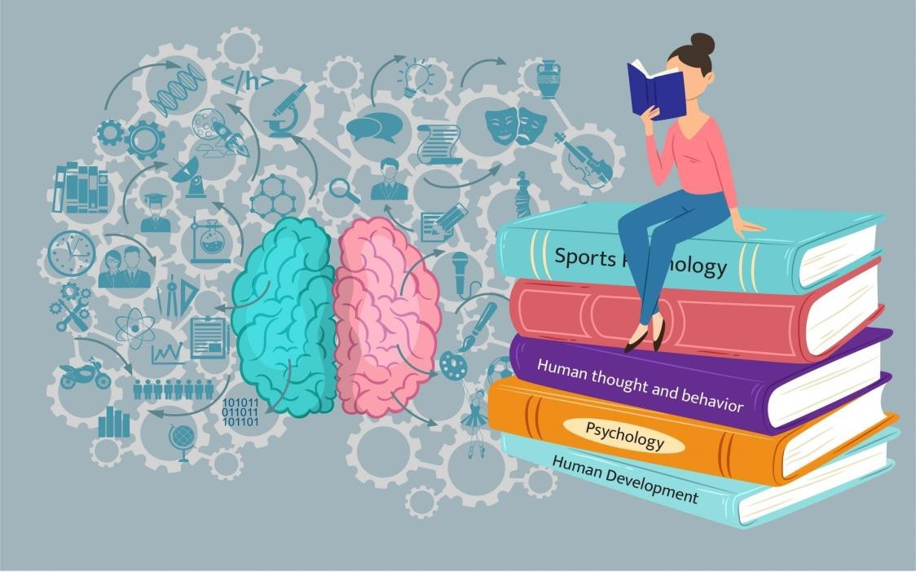
The psychology of learning focuses on a range of topics related to how people learn and interact with their environments.

Slide 4
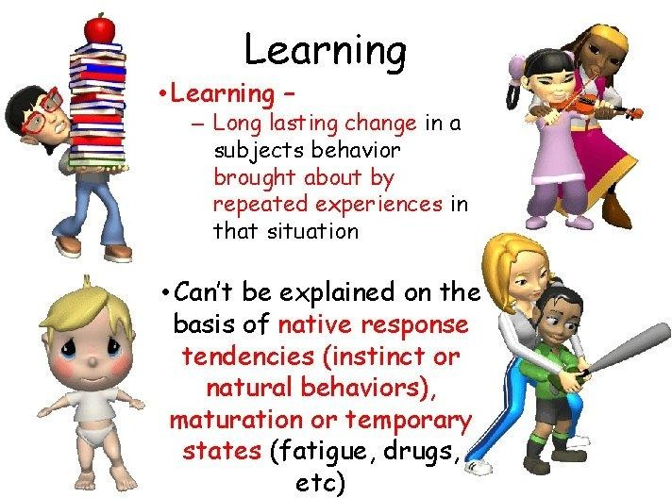

Slide 5
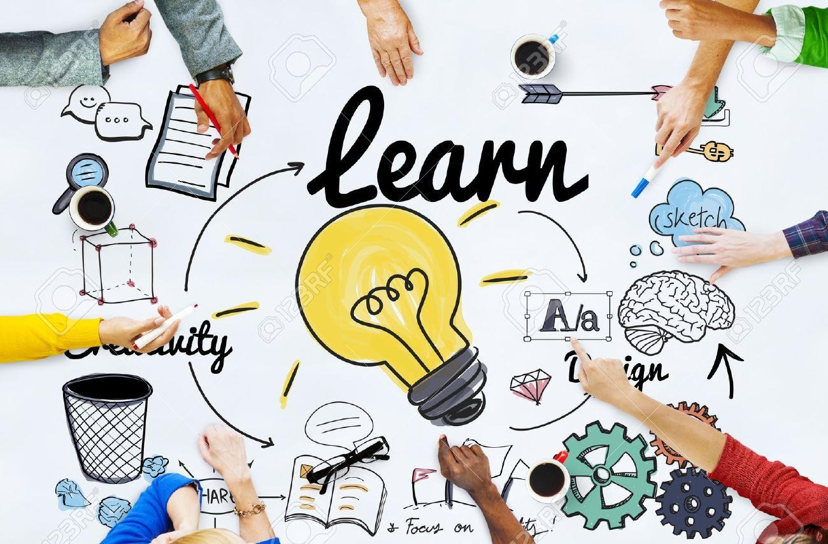
Types of Learning
Learning is traditionally divided into three categories:
Associative learning
Non-associative learning
Cognitive learning

Slide 6
Associative learning
Associative learning occurs when we form associations, or connections, among stimuli, behaviors, or both. In other words, if A happens, then B is likely to follow. This type of learning helps us to predict the future based on past experience.
The formation of associations, or connections, among stimuli and behaviors.

Slide 7
Two important types of associative learning are:
Classical conditioning
Operant conditioning
In classical conditioning, we form associations between pairs of stimuli that occur sequentially in time.

Slide 8
Classical conditioning example
If a child sees a bee for the first time and then gets stung, the child forms a connection between seeing bees and the pain of being stung. The next time a bee flies by, the child is likely to feel quite frightened.

Slide 9
In operant conditioning, we form associations between behaviors and their consequences.
Example:
If you study hard, you will get good grades.

Slide 10
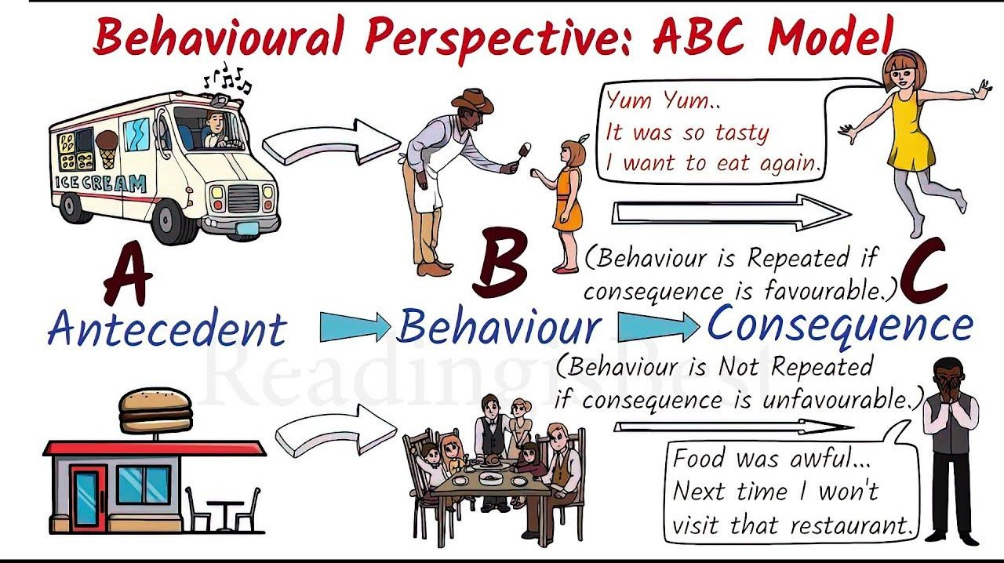


Slide 11
Applications of Operant Conditioning
Reinforcement: The process by which a stimulus increases the probability that a preceding behavior will be repeated (Feldman, 2011).
Primary: Food, water and adequate warmth
Secondary: stimulus that has been associated with something that satisfies a need
Example. Money
Positive: when presented this type of reinforcement strengthens a response
Example. Throughout the semester, the professor provides verbal feedback and recognition to students who actively participate.
Negative: This type of reinforcement strengthens a response by its absence.
Example. Ending class 15 minutes early if students didn’t disturb the class.

Slide 12

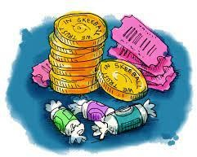
Applications of Operant Conditioning
Education System
Gaming Etc.
Operant Conditioning is used in enhancing decision making power. Operant conditioning techniques can be integrated into the treatment to reinforce positive decision-making behaviors. Individuals can be rewarded or praised for making good decisions and discouraged from repeating poor choices.

Slide 13
Non-associative learning involves changes in the magnitude of responses to a single stimulus rather than the formation of connections between stimuli.
Non-associative learning is a type of learning that occurs without the association of two stimuli. It is a simple form of learning that is common to all animals.
Two important types of non-associative learning are:
Habituation
Sensitization

Slide 14
Habituation reduces our reactions to repeated experiences that have already been evaluated and found to be unchanging and harmless.
Example:
You might sleep better the second night than the first in the same hotel because you have adjusted to the unfamiliar noises in that environment.
Imagine living near a busy train track. When the trains first start passing by, the noise is highly disruptive, and you may wake up every time. However, with time, you become accustomed to the noise, and it no longer disrupts your sleep.

Slide 15
Sensitization increases our reactions to a range of stimuli following exposure to one strong stimulus. Following an earthquake, people experience exaggerated responses to movement, light, or noise.
Sensitization is an increase in the response to a repeated stimulus over time. For example, if you are bitten by a dog, you may become more afraid of dogs in general. This increased fear is a result of sensitization.
Example:
If you are awakened by a loud crash, even if you figure out it’s just your roommate coming home late at night, it might be harder to get back to sleep because of your suddenly increased state of arousal. Every little sound now seems magnified.

Slide 16
In sensitization, the organism is simply exposed to a stimulus repeatedly. Over time, the organism becomes more sensitive to the stimulus, even though the stimulus itself has not changed. This is likely due to changes in the organism's nervous system.
For example, if a rat is exposed to a loud noise repeatedly, it will become more sensitive to the noise. This means that the rat will startle more easily in response to the noise. However, the rat does not need to learn to associate the noise with a particular response. The rat simply becomes more sensitive to the noise in general.

Slide 17
Non-associative learning is important because it allows animals to adapt to their environment. For example, habituation allows animals to ignore irrelevant stimuli and focus on important stimuli. Sensitization allows animals to learn to avoid dangerous stimuli.
Examples of non-associative learning in everyday life:
A baby cries when they hear a loud noise, but over time, they become habituated to the noise and stop crying.
A dog barks at the sound of the doorbell, but over time, they become habituated to the sound and stop barking.
A child is afraid of the dark, but over time, they become habituated to the dark and are no longer afraid.
A person develops an allergy to peanuts after eating them several times. This is an example of sensitization.
A person becomes more anxious after giving a presentation at work. This is an example of sensitization.

Slide 18
Cognitive Learning: Cognitive Psychologists see learning as purposeful, not mechanical.
People and animals can learn by thinking about something, or by watching others.
Two kinds of learning that involve cognitive factors are:
Latent Learning
Observational Learning

Slide 19
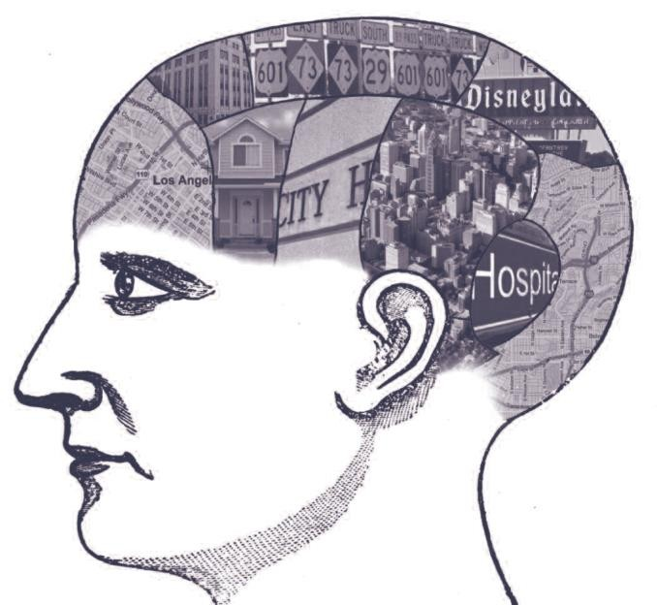
1. Latent Learning
Learning that remains hidden until needed.
Creating mental pictures or cognitive maps.
Latent learning is a type of learning that occurs without reinforcement and is not immediately apparent. It is a type of cognitive learning, because it requires the learner to understand the relationship between stimuli and events.
On a piece of paper draw the layout of one of the following:
McDonalds
Subway
Hostel to Classroom
Your Home

Slide 20
In latent learning, a rat might explore the maze without a reward. Although its behavior doesn't change immediately, the rat has acquired a mental map of the maze. Later, when a reward is introduced, the rat navigates the maze as efficiently as the rat that received rewards from the start. The learning was "latent" because it wasn't demonstrated until a motivating factor (the reward) was introduced.

Slide 21
Imagine you're a college student who has been commuting to and from your university for a semester. You've been taking the same route every day, from your home to the university, because that's the way your friends showed you, and it's the path you've become comfortable with. You've learned the route, but you haven't paid much attention to the details or alternative paths.
Latent Learning: One day, your friends offer you a ride to university, and you passively notice that they take a different route that's shorter and less congested. Although you weren't actively trying to learn this new route, you've gained knowledge about it.
Realization: Later in the semester, your regular route is unexpectedly closed due to construction. Remembering the shorter route you observed with your friends, you decide to take it. You've used the knowledge you gained earlier without an immediate reward, and it has now become valuable.

Slide 22
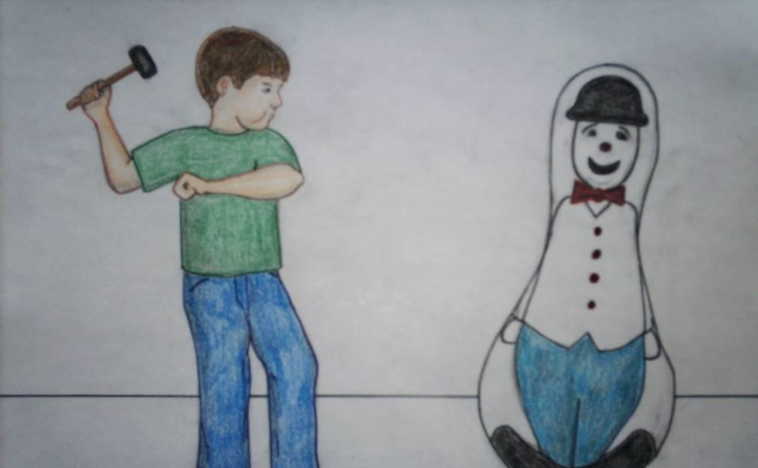
2. Observational learning, also known as social learning or modeling, occurs when one organism learns by watching the actions of another organism.
Given by Albert Bandura:
We acquire knowledge and skills by observing, and imitating others.
Most psychologists agree that media plays a role in shaping behavior.

Slide 23
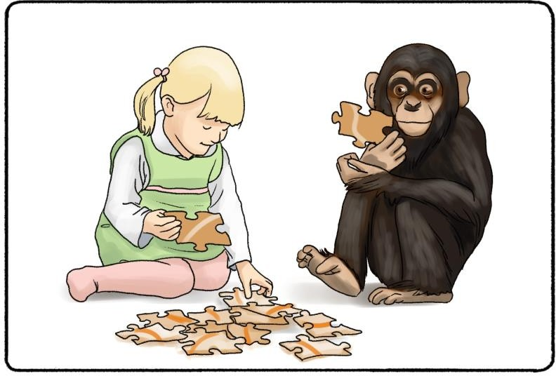
Observational learning example:
If your knowledge of table manners does not extend to the many forks, knives, and spoons at a fancy dinner, you might want to watch what others do before diving into your food.

